Slide 1
Internet Of Things - 18CSE379T
Distance Sensor
SOUMYA RATHORE- RA2011029010033
SHALEEN DUBEY- RA2011029010054

Slide 2
Abstract
Our project is about Automatic Bottle Filling Machines with the novelty which not only improves it’s functionality but also helps to achieve less wastage of resources inside the machine like any other liquid in it.
This project revolves around the idea of creating an Automatic System which not only senses but also measures the dimensions of the object in front of the machine using Smart Sensors and then sends a Sensor-Request to fill the liquid upto that proportions.

Slide 3
About
Automatic Filling Machines have a vast use case, some of them include many offices and public places. Where people tend to use a coffee dispensing machine or water bottle filling machine which leads to wastage of the respective resources due to the machine’s lack of correct judgment as to when to stop filling.
To prevent that from happening, this project uses not one but two Distance Sensors. One of which senses the distance of the object to be filled from the machine and the other measures the dimensions of the object which would be predefined to the machine.

Slide 4
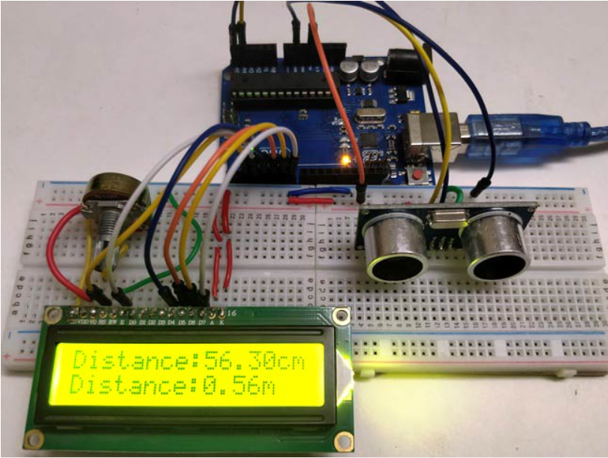
Application
The application that it serves is how basic distance sensors can be used for Automatic and day-to-day work.

Slide 5
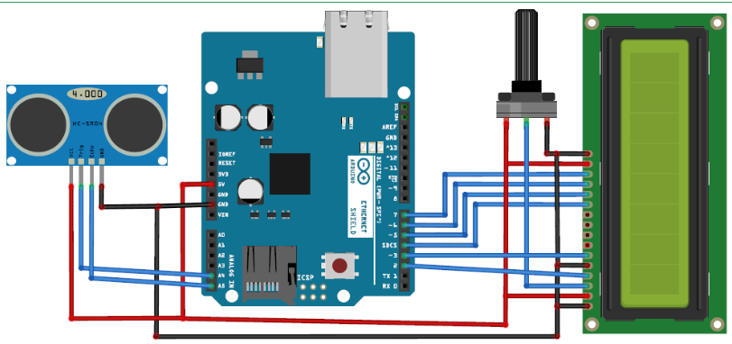
Architecture

Slide 6
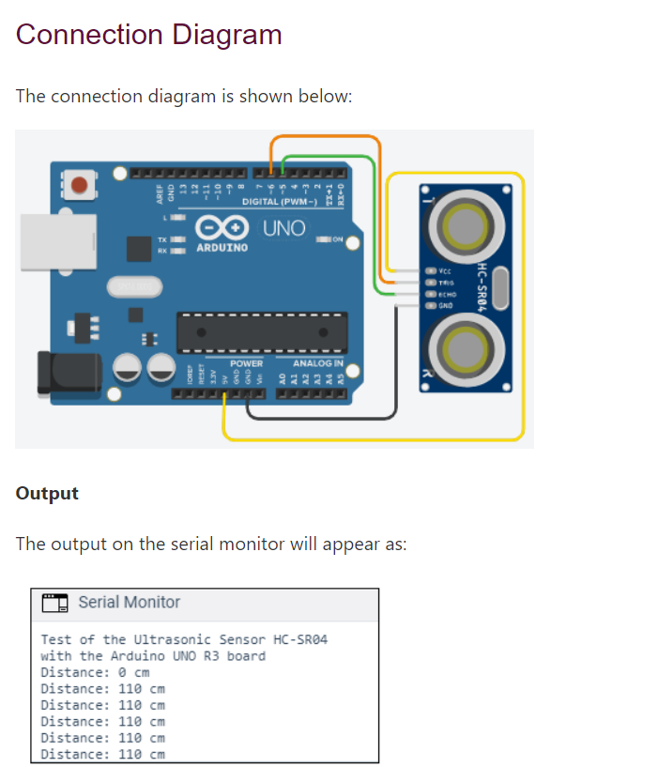

Slide 7
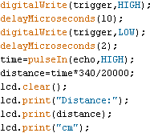
Pseudo Code

Slide 8
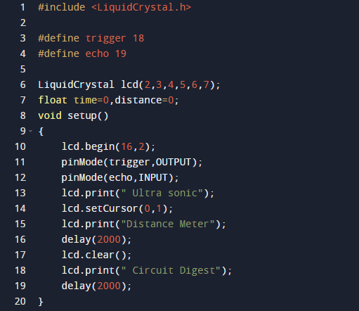

Slide 9
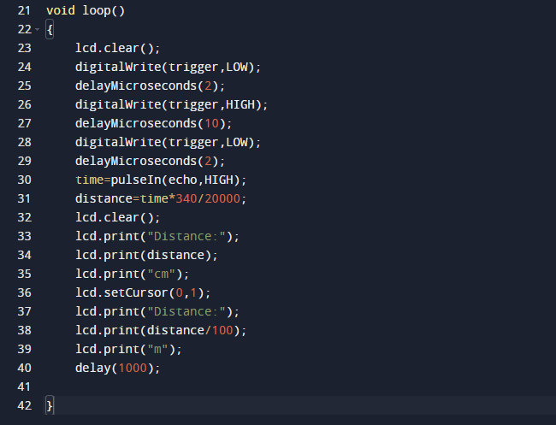

Slide 10
Working Code
The complete code for this Ultrasonic Distance Measurement Project is as follows:
In the code we read time by using pulseIn(pin). And then perform the calculations and display the result on 16x2 LCD by using appropriate functions.

Slide 11
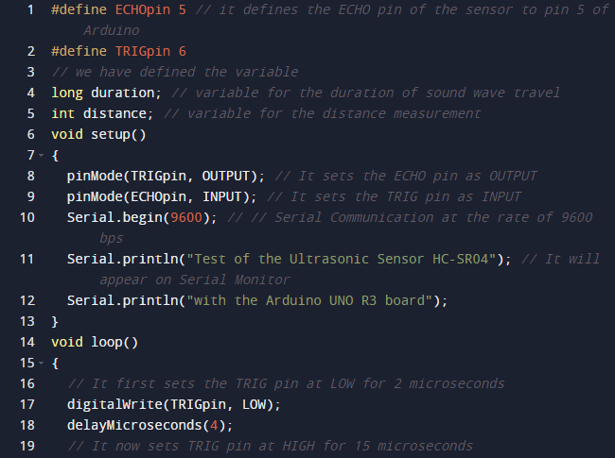

Slide 12
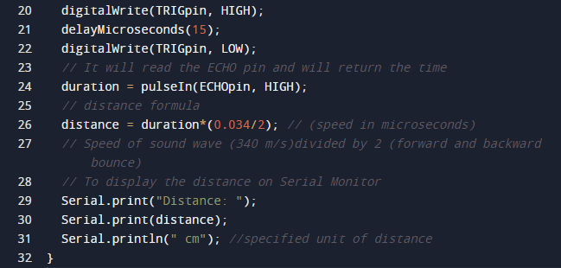

Slide 13
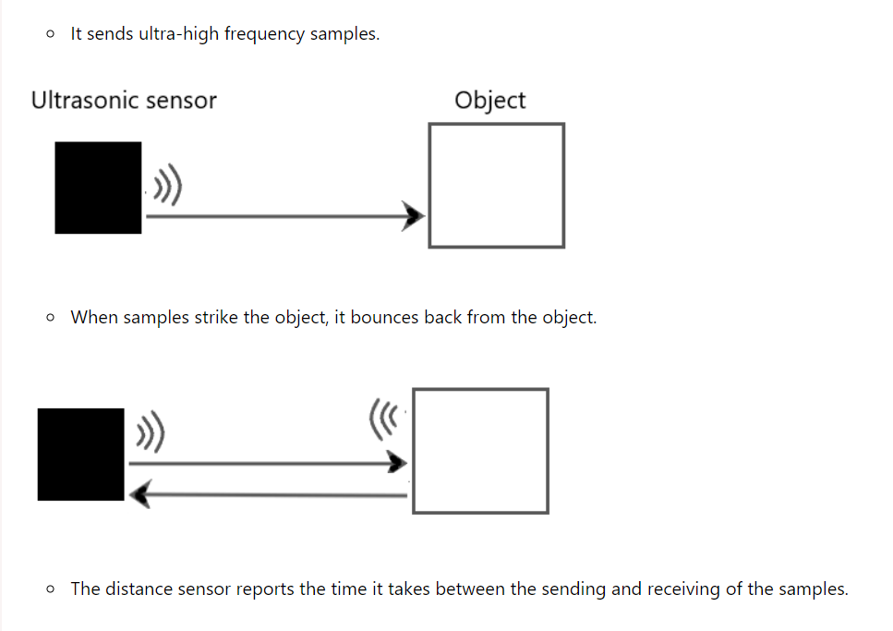
Working of the HC-SRO4 Distance Sensor

Slide 14
Working
Components Required: An Object, two holders, and two distance sensors.
One sensor is placed at the middle of the machine whereas the other sensor is placed towards the right side which measures the height of the object.
One distance sensor will measure the distance of the object from the machine and other sensor will measure the dimensions of the object in front of the machine. Then it will give the value to the sensor which is measured in centimeters. According to which the liquid will be filled in the object present in front of it
These dimensions help in providing the information of the object present in front of the machine which helps to measure the amount of liquid to be poured.

Slide 15
Working
This dimension is then measured with the help of the formula of Distance given by, D = S * T
The frequency sent by the sensor to the object is then noted by the sensor which shows how far or close it is placed.
The height of the object is measured from another sensor.
The liquid filled is according to the data sent back to the sensor which calculates the amount of the fluid which needs to be processed in order to fill the object.
This helps in pouring the accurate amount of the liquid to be filled which reduces the wastage to the significant amount.

Slide 16
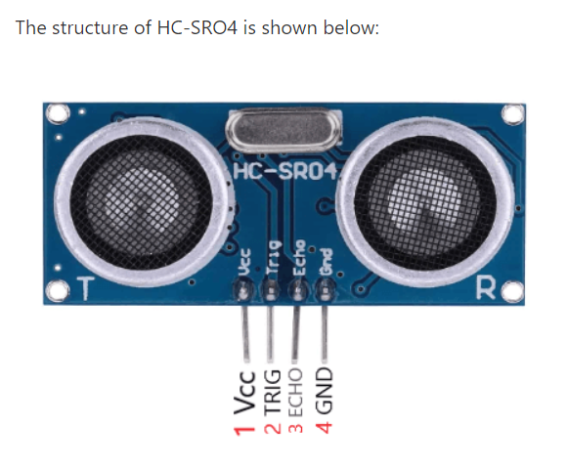
HC-SRO4

Slide 17
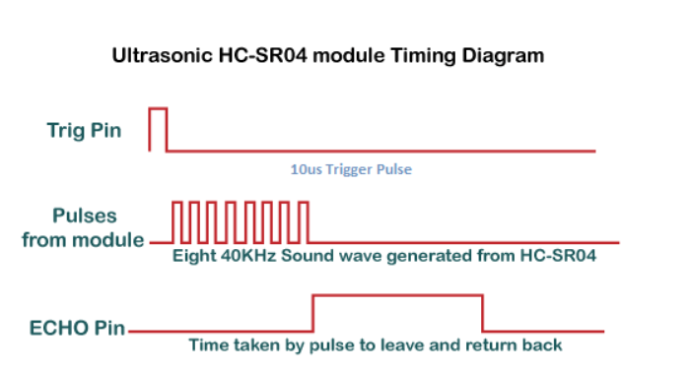
Timing Diagram

Slide 18
Hardware Required
The components required to create the project are listed below:
Arduino UNO R3 board (We can also use any Arduino board)
Jump wires
Ultrasonic sensor HC-SRO4
Breadboard

Slide 19
Steps To Upload The Code To The Project
The steps are listed below:
Open the Arduino IDE.
Select the type of board from Tools -> Board -> Arduino UNO.
Select the port from Tools -> Port -> COM..
Upload the sketch to the connection diagram.

Slide 20
Result
There is a better efficient way with less wastage of resources and a better usage for multiple people.
Future Enhancement
How we can make the working of this project more efficient. We can try to make our project work with a single sensor without compromising on the functionalities. We will not only try to Reduce the cost but also reduce the space the machine takes. We will try to bring more features to the project (not only for a few liquids). Try to cut down the time duration to make it work faster. We will also try to make accessibility a little bit easier. We will also try to make the machine work remotely i.e. try to make it work from any mobile devices through automation.

Slide 21
Conclusion
Curated and Implemented an Automatic Filling System with a few changes in the currently present system to make it more efficient and resourceful with less wastage.

Slide 22
References
Team, T. A. (n.d.). Getting started with the web editor: Arduino documentation. Arduino Documentation | Arduino Documentation. Retrieved November 26, 2022, from https://docs.arduino.cc/arduino-cloud/getting-started/getting-started-web-editor
Arduino ultrasonic distance sensor - javatpoint. www.javatpoint.com. (n.d.). Retrieved November 26, 2022, from https://www.javatpoint.com/arduino-ultrasonic-distance-sensor
Distance measurement using ultrasonic sensor and Arduino. Distance Measurement using Arduino Ultrasonic Sensor: Code & Circuit Diagram. (n.d.). Retrieved November 26, 2022, from https://circuitdigest.com/microcontroller-projects/arduino-ultrasonic-sensor-based-distance-measurement
System. (2010, August 26). Pseudo code clarification. Arduino Forum. Retrieved November 26, 2022, from https://forum.arduino.cc/t/pseudo-code-clarification/44717/6
Distance measurement using Arduino ultrasonic sensor. Arduino Project Hub. (n.d.). Retrieved November 26, 2022, from https://create.arduino.cc/projecthub/Junezriyaz/distance-measurement-using-arduino-ultrasonic-sensor-409169

